Slide 1
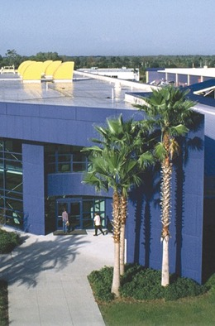
April 26, 2025
Notes:
Research and develop energy technologies that enhance Florida’s and the nation’s economy and environment, and to educate the public, students and practitioners on the results of the research.
The mission of the FSEC education department is to do that education part. We accomplish that through curriculum development, professional development for teachers and outreach events. EnergyWhiz is our annual outreach event for K-12 students, teachers, parents and their friends and families.

Slide 2
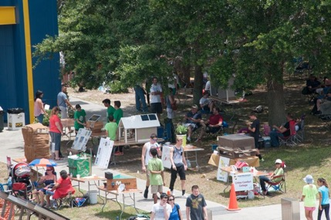
What is EnergyWhiz?
A Celebration of Learning!
It is a hybrid STEAM event for K-12 students that has:
- virtual & in-person parts
hands-on renewable energy themed projects created by students
Support from industry, scientists, educators and researchers
Notes:
EnergyWhiz is the umbrella term for a Science, Technology, Engineering, Art, and Mathematics –rich event that has a focus on Energy and the Environment. Competitions reflect the research areas at FSEC provide an opportunity for students to showcase their projects. Students develop projects in various categories that are create, engineered and constructed over days, weeks or months and then come together for EnergyWhiz as the culminating event. Students submit their project information online prior to the in-person EnergyWhiz event.

Slide 3
EnergyWhiz.com
Notes:
EnergyWhiz is the umbrella term for a Science, Technology, Engineering, Art, and Mathematics –rich event that has a focus on Energy and the Environment. Competitions reflect the research areas at FSEC provide an opportunity for students to showcase their projects. Students develop projects in various categories that are create, engineered and constructed over days, weeks or months and then come together for EnergyWhiz as the culminating event. Students submit their project information online prior to the in-person EnergyWhiz event.

Slide 4
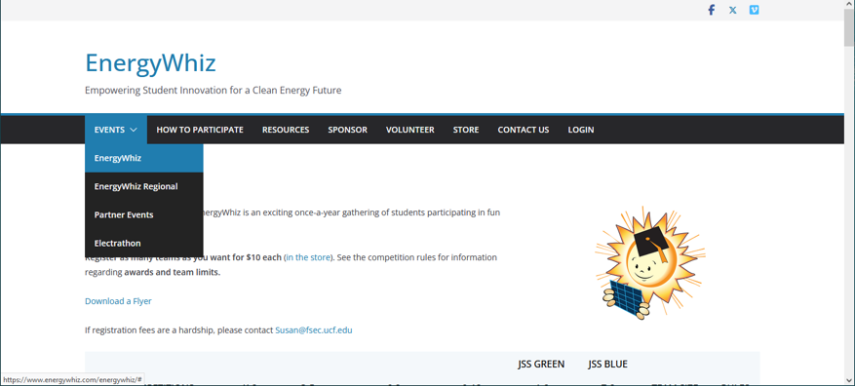
EnergyWhiz.com
Notes:
EnergyWhiz is the umbrella term for a Science, Technology, Engineering, Art, and Mathematics –rich event that has a focus on Energy and the Environment. Competitions reflect the research areas at FSEC provide an opportunity for students to showcase their projects. Students develop projects in various categories that are create, engineered and constructed over days, weeks or months and then come together for EnergyWhiz as the culminating event. Students submit their project information online prior to the in-person EnergyWhiz event.

Slide 5
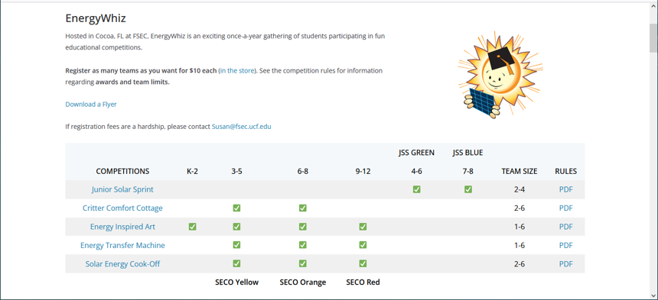
EnergyWhiz.com
Notes:
EnergyWhiz is the umbrella term for a Science, Technology, Engineering, Art, and Mathematics –rich event that has a focus on Energy and the Environment. Competitions reflect the research areas at FSEC provide an opportunity for students to showcase their projects. Students develop projects in various categories that are create, engineered and constructed over days, weeks or months and then come together for EnergyWhiz as the culminating event. Students submit their project information online prior to the in-person EnergyWhiz event.

Slide 6
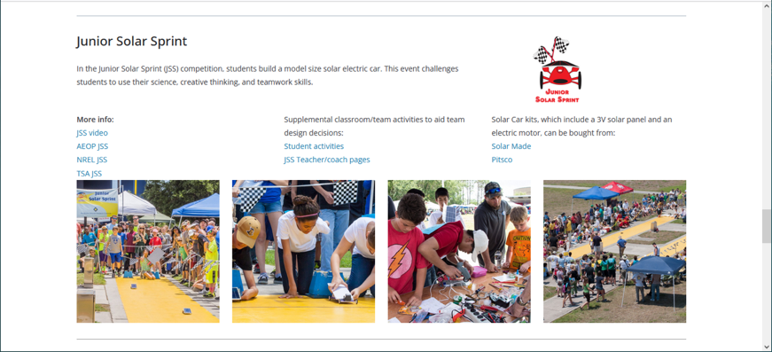
EnergyWhiz.com
Notes:
EnergyWhiz is the umbrella term for a Science, Technology, Engineering, Art, and Mathematics –rich event that has a focus on Energy and the Environment. Competitions reflect the research areas at FSEC provide an opportunity for students to showcase their projects. Students develop projects in various categories that are create, engineered and constructed over days, weeks or months and then come together for EnergyWhiz as the culminating event. Students submit their project information online prior to the in-person EnergyWhiz event.

Slide 7
Important Dates
September 1, 2024
Enrollment Opens
$10 per team
April 4, 2025, 6:00 PM
Project Webpage Due & Fees Paid
April 11, 2025
Design Judging Begins
April 17, 2025
Project Feedback to Teachers & Coaches
April 23, 2025, 3:00 PM
Teachers & Coaches Confirm Which Teams Will Compete at EnergyWhiz
April 26, 2025, 8:00 AM – 3:30 PM
EnergyWhiz at FSEC
1679 Clearlake Road
Cocoa, FL 32922
Notes:
April 11 - Using the completed project websites, Judges grade projects based on design criteria.
April 17 - Based on the design judges, feedback is provided to teachers and coaches, allowing students to improve their physical projects and help to decide which teams should compete at EnergyWhiz.
April 23 - By 3PM the teams that will be competing at EnergyWhiz must be confirmed.

Slide 8
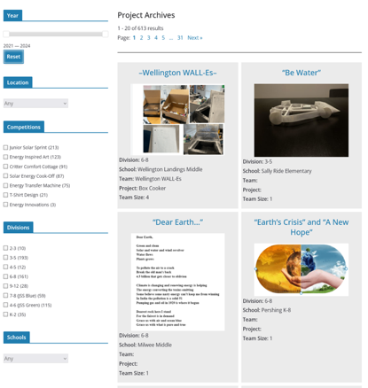
EnergyWhiz Project Webpages
EnergyWhiz.com
Teams create a webpage that documents their project’s evolution
Online design log and 0utreach tool

Slide 9
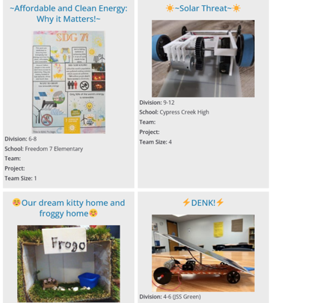
Evaluation and Judging
Student and team projects are reviewed online.
Projects are evaluated and given scores by a team of judges.
Judges represent business, industry, energy research, education and public outreach.

Slide 10
EnergyWhiz Competitions
Notes:
EnergyWhiz is the umbrella term for a Science, Technology, Engineering, Art, and Mathematics –rich event that has a focus on Energy and the Environment. Susan likes to call it our STEAM-EE Mission. Competitions that reflect the research areas at FSEC provide an opportunity for students to showcase their projects. This STEAM-EE event occurs annually at FSEC ERC. Students develop projects in six categories (seven if you count Electrathon) that are engineered over days, weeks or months and then come together for EnergyWhiz as the culminating event. More about the competitions in a moment.

Slide 11
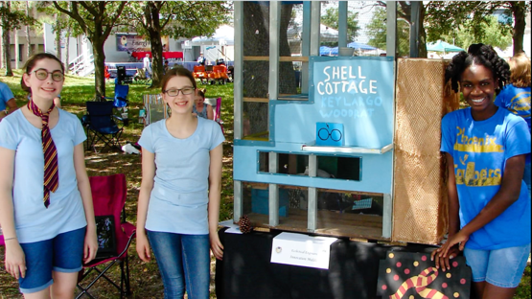
EnergyWhiz Competitions
Critter Comfort Cottage
Energy Efficient Building Design
Grades 3-8
Shell Cottage (Eclectical Engineers) Key Largo Woodrat
Innovation Middle
Notes:
EnergyWhiz is the umbrella term for a Science, Technology, Engineering, Art, and Mathematics –rich event that has a focus on Energy and the Environment. Susan likes to call it our STEAM-EE Mission. Competitions that reflect the research areas at FSEC provide an opportunity for students to showcase their projects. This STEAM-EE event occurs annually at FSEC ERC. Students develop projects in six categories (seven if you count Electrathon) that are engineered over days, weeks or months and then come together for EnergyWhiz as the culminating event. More about the competitions in a moment.

Slide 12
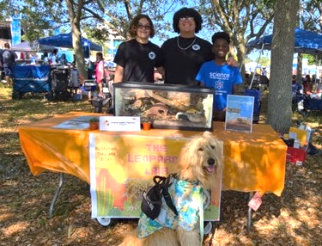
EnergyWhiz Competitions
Students:
create and promote their energy efficient home that they have designed for a critter of interest.
research their critter & energy efficient design appropriate for their critter
Develop promotional materials about their critter and its abode.
Create a webpage about their project
The Leopard Lair (Leaping Lizards)
Yellow Leopard Gecko
Pershing K-8
Notes:
EnergyWhiz is the umbrella term for a Science, Technology, Engineering, Art, and Mathematics –rich event that has a focus on Energy and the Environment. Susan likes to call it our STEAM-EE Mission. Competitions that reflect the research areas at FSEC provide an opportunity for students to showcase their projects. This STEAM-EE event occurs annually at FSEC ERC. Students develop projects in six categories (seven if you count Electrathon) that are engineered over days, weeks or months and then come together for EnergyWhiz as the culminating event. More about the competitions in a moment.

Slide 13
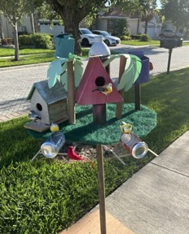
EnergyWhiz Competitions
Some critters students have researched:
Bees
Bearded Dragon
Bird
Cat
Caterpillar
Chicken
Dog
Ferret
Fish
Frog
Gecko
Guinea Pig
Guppies
Hamster
Hedgehog
Key Largo Woodrat
Koala
Krill
Lizards
Meerkat
Rabbit
Sea Turtle Hatchling(s)
Snake
Speckled Tortoise
Spider
Squirrel
Turtles
Worms
B.E.C. (Birds Ecological Community)
Birds
Osceola Science Charter
Notes:
EnergyWhiz is the umbrella term for a Science, Technology, Engineering, Art, and Mathematics –rich event that has a focus on Energy and the Environment. Susan likes to call it our STEAM-EE Mission. Competitions that reflect the research areas at FSEC provide an opportunity for students to showcase their projects. This STEAM-EE event occurs annually at FSEC ERC. Students develop projects in six categories (seven if you count Electrathon) that are engineered over days, weeks or months and then come together for EnergyWhiz as the culminating event. More about the competitions in a moment.

Slide 14
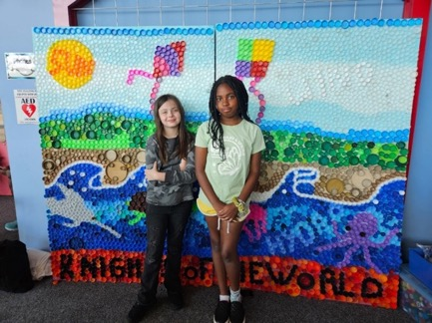
EnergyWhiz Competitions
Energy Inspired Art
Any Renewable Energy Technology or
Sustainability Message
Grades K-12
Knights of the World
Bottle Cap Mural
Lockmar Elementary
Notes:
EnergyWhiz is the umbrella term for a Science, Technology, Engineering, Art, and Mathematics –rich event that has a focus on Energy and the Environment. Susan likes to call it our STEAM-EE Mission. Competitions that reflect the research areas at FSEC provide an opportunity for students to showcase their projects. This STEAM-EE event occurs annually at FSEC ERC. Students develop projects in six categories (seven if you count Electrathon) that are engineered over days, weeks or months and then come together for EnergyWhiz as the culminating event. More about the competitions in a moment.

Slide 15
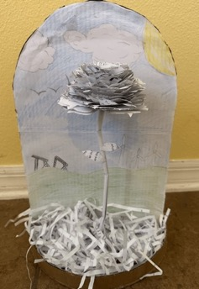
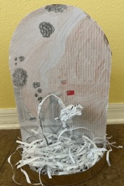
EnergyWhiz Competitions
Students are challenged to:
create artwork inspired by an aspect of renewable energy, energy efficiency and/or climate science.
use any art form - media, visual, video performance, musical or literary.
present their art through a web page and exhibit or perform their piece in-person at EnergyWhiz.
Two Sides to the Same World
Timber Creek High
Notes:
EnergyWhiz is the umbrella term for a Science, Technology, Engineering, Art, and Mathematics –rich event that has a focus on Energy and the Environment. Susan likes to call it our STEAM-EE Mission. Competitions that reflect the research areas at FSEC provide an opportunity for students to showcase their projects. This STEAM-EE event occurs annually at FSEC ERC. Students develop projects in six categories (seven if you count Electrathon) that are engineered over days, weeks or months and then come together for EnergyWhiz as the culminating event. More about the competitions in a moment.

Slide 16
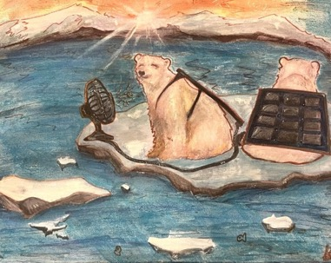
EnergyWhiz Competitions
Artwork submitted includes:
Paintings
Sculptures
Models
Poetry
Short Stories
Plays
Shadowboxes
Title: Cooling Down
Paint on Canvas
Lyman High
Notes:
EnergyWhiz is the umbrella term for a Science, Technology, Engineering, Art, and Mathematics –rich event that has a focus on Energy and the Environment. Susan likes to call it our STEAM-EE Mission. Competitions that reflect the research areas at FSEC provide an opportunity for students to showcase their projects. This STEAM-EE event occurs annually at FSEC ERC. Students develop projects in six categories (seven if you count Electrathon) that are engineered over days, weeks or months and then come together for EnergyWhiz as the culminating event. More about the competitions in a moment.

Slide 17
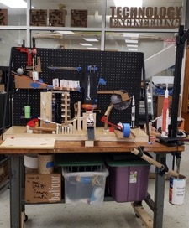
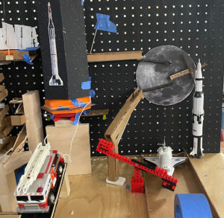
EnergyWhiz Competitions
Energy Transfer Machine
Battery (Hydrogen Fuel Cells)
Grades 3-12
Milestones in Space Exploration
Kennedy Middle
Notes:
EnergyWhiz is the umbrella term for a Science, Technology, Engineering, Art, and Mathematics –rich event that has a focus on Energy and the Environment. Susan likes to call it our STEAM-EE Mission. Competitions that reflect the research areas at FSEC provide an opportunity for students to showcase their projects. This STEAM-EE event occurs annually at FSEC ERC. Students develop projects in six categories (seven if you count Electrathon) that are engineered over days, weeks or months and then come together for EnergyWhiz as the culminating event. More about the competitions in a moment.

Slide 18
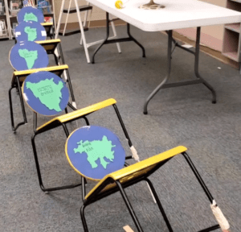
EnergyWhiz Competitions
Students:
transform materials into an unusual contraption that accomplishes a task using a variety of energy transfers.
record a video of their contraption (ET Machine) performing its energy transfers from start to finish
submit their video for judging on a team-created web page.
Around the World
Carillon Elementary
Notes:
EnergyWhiz is the umbrella term for a Science, Technology, Engineering, Art, and Mathematics –rich event that has a focus on Energy and the Environment. Susan likes to call it our STEAM-EE Mission. Competitions that reflect the research areas at FSEC provide an opportunity for students to showcase their projects. This STEAM-EE event occurs annually at FSEC ERC. Students develop projects in six categories (seven if you count Electrathon) that are engineered over days, weeks or months and then come together for EnergyWhiz as the culminating event. More about the competitions in a moment.

Slide 19
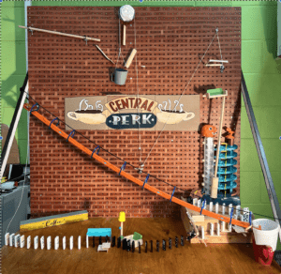
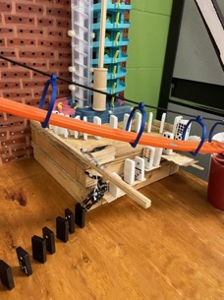
EnergyWhiz Competitions
ET Machines
Anything goes!
Compact or long and sprawling
Precision matters - hitting that 1 minute mark is important!
Central Perks
Winter Springs High
Notes:
EnergyWhiz is the umbrella term for a Science, Technology, Engineering, Art, and Mathematics –rich event that has a focus on Energy and the Environment. Susan likes to call it our STEAM-EE Mission. Competitions that reflect the research areas at FSEC provide an opportunity for students to showcase their projects. This STEAM-EE event occurs annually at FSEC ERC. Students develop projects in six categories (seven if you count Electrathon) that are engineered over days, weeks or months and then come together for EnergyWhiz as the culminating event. More about the competitions in a moment.

Slide 20
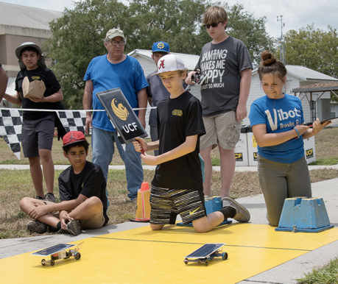
EnergyWhiz Competitions
Junior Solar Sprint
Photovoltaics, Electric Vehicles
Grades 4-8
This is a national program
Partners include:
AEOP, TSA, SECME & NSTA

Slide 21
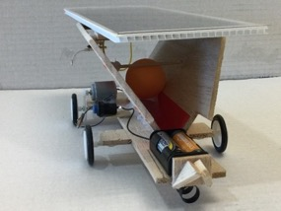
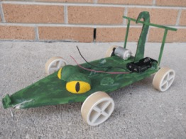
EnergyWhiz Competitions
Teams:
design and build a model-sized vehicle that uses a regulation solar electric (photovoltaic) panel and motor.
create all other parts of their car using materials of their choosing.
present their designs and evidence of their engineering process through a web page
Renegade Runners
NSU University School
Swamp Chomps
Milwee Middle

Slide 22
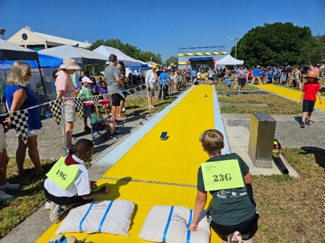
EnergyWhiz Competitions
Teams:
bring their vehicles to EnergyWhiz to compete in the 20 meter, wire-guided race.
are evaluated on their vehicle’s design, innovation, and performance
top overall team is offered an all-expense paid trip to compete in the National JSS event

Slide 23
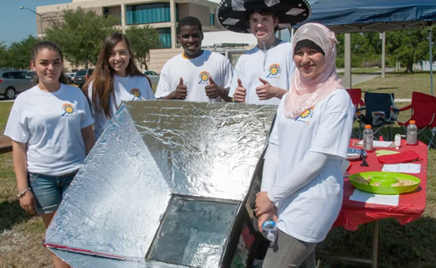
EnergyWhiz Competitions
Solar Energy Cook-off Solar Thermal
A Design and Culinary Competition
Notes:
EnergyWhiz is the umbrella term for a Science, Technology, Engineering, Art, and Mathematics –rich event that has a focus on Energy and the Environment. Susan likes to call it our STEAM-EE Mission. Competitions that reflect the research areas at FSEC provide an opportunity for students to showcase their projects. This STEAM-EE event occurs annually at FSEC ERC. Students develop projects in six categories (seven if you count Electrathon) that are engineered over days, weeks or months and then come together for EnergyWhiz as the culminating event. More about the competitions in a moment.

Slide 24
EnergyWhiz Competitions
Each team:
designs and builds a functional solar cooker
documents the design, build and testing of their cooker
uses their creation to cook a dish of their choosing.
Notes:
EnergyWhiz is the umbrella term for a Science, Technology, Engineering, Art, and Mathematics –rich event that has a focus on Energy and the Environment. Susan likes to call it our STEAM-EE Mission. Competitions that reflect the research areas at FSEC provide an opportunity for students to showcase their projects. This STEAM-EE event occurs annually at FSEC ERC. Students develop projects in six categories (seven if you count Electrathon) that are engineered over days, weeks or months and then come together for EnergyWhiz as the culminating event. More about the competitions in a moment.

Slide 25
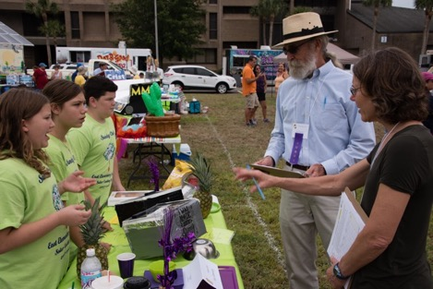
EnergyWhiz Competitions
Each team:
creates a web page to share their cooker design and culinary information.
is evaluated by expert judges who review their cooker design information and their final culinary product.
Notes:
EnergyWhiz is the umbrella term for a Science, Technology, Engineering, Art, and Mathematics –rich event that has a focus on Energy and the Environment. Susan likes to call it our STEAM-EE Mission. Competitions that reflect the research areas at FSEC provide an opportunity for students to showcase their projects. This STEAM-EE event occurs annually at FSEC ERC. Students develop projects in six categories (seven if you count Electrathon) that are engineered over days, weeks or months and then come together for EnergyWhiz as the culminating event. More about the competitions in a moment.

Slide 26
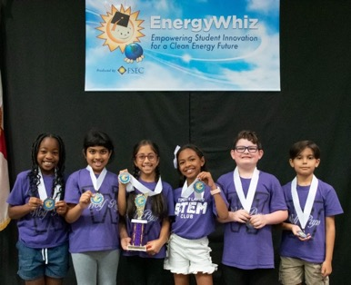
Winning EnergyWhiz teams receive trophies and medallions!
Notes:
EnergyWhiz is the umbrella term for a Science, Technology, Engineering, Art, and Mathematics –rich event that has a focus on Energy and the Environment. Susan likes to call it our STEAM-EE Mission. Competitions that reflect the research areas at FSEC provide an opportunity for students to showcase their projects. This STEAM-EE event occurs annually at FSEC ERC. Students develop projects in six categories (seven if you count Electrathon) that are engineered over days, weeks or months and then come together for EnergyWhiz as the culminating event. More about the competitions in a moment.

Slide 27
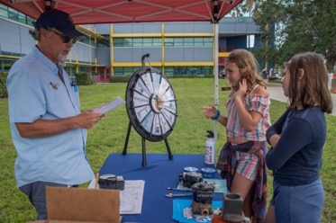
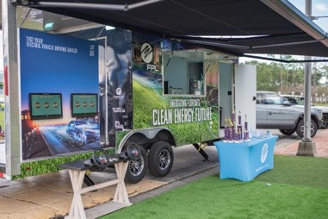
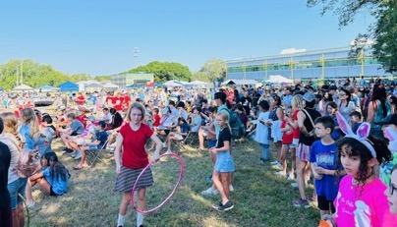
Other Activities at EnergyWhiz
Energy Quest (a scavenger hunt)
Interactive exhibits
Food Trucks
Go Cart Races
Notes:
EnergyWhiz is the umbrella term for a Science, Technology, Engineering, Art, and Mathematics –rich event that has a focus on Energy and the Environment. Susan likes to call it our STEAM-EE Mission. Competitions that reflect the research areas at FSEC provide an opportunity for students to showcase their projects. This STEAM-EE event occurs annually at FSEC ERC. Students develop projects in six categories (seven if you count Electrathon) that are engineered over days, weeks or months and then come together for EnergyWhiz as the culminating event. More about the competitions in a moment.

Slide 28
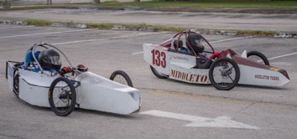
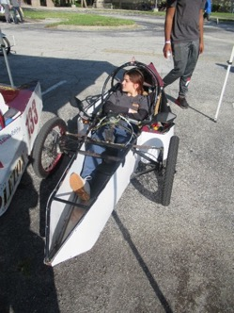
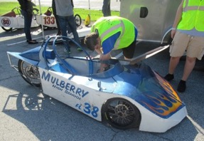
Other Activities at EnergyWhiz
Electrathon Go Cart Races
Notes:
EnergyWhiz is the umbrella term for a Science, Technology, Engineering, Art, and Mathematics –rich event that has a focus on Energy and the Environment. Susan likes to call it our STEAM-EE Mission. Competitions that reflect the research areas at FSEC provide an opportunity for students to showcase their projects. This STEAM-EE event occurs annually at FSEC ERC. Students develop projects in six categories (seven if you count Electrathon) that are engineered over days, weeks or months and then come together for EnergyWhiz as the culminating event. More about the competitions in a moment.

Slide 29
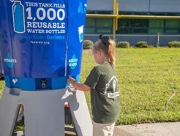
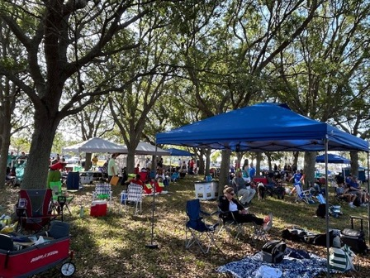
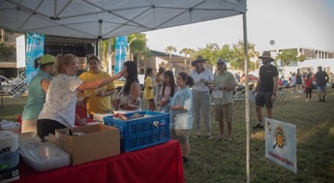
Other Activities at EnergyWhiz
Parents, friends and siblings enjoy the day, too!
Notes:
EnergyWhiz is the umbrella term for a Science, Technology, Engineering, Art, and Mathematics –rich event that has a focus on Energy and the Environment. Susan likes to call it our STEAM-EE Mission. Competitions that reflect the research areas at FSEC provide an opportunity for students to showcase their projects. This STEAM-EE event occurs annually at FSEC ERC. Students develop projects in six categories (seven if you count Electrathon) that are engineered over days, weeks or months and then come together for EnergyWhiz as the culminating event. More about the competitions in a moment.

Slide 30
Resources
EnergyWhiz.com
How to and other videos
Competition rules and registration info
Gallery – photos of each competition
Teacher workshops:
JSS workshop - Ft. Lauderdale, November 9 - $10 per person, free basic JSS kit and lunch

Slide 31
Questions?

Slide 32
Contact Susan Schleith
susan@fsec.ucf.edu
or
321-638-1017

