Slide 1
Energy Transfer Machine
Penny Hall and Susan Schleith
Maker Discovery Day!
Florida Solar Energy Center
October 11, 2019

Slide 2
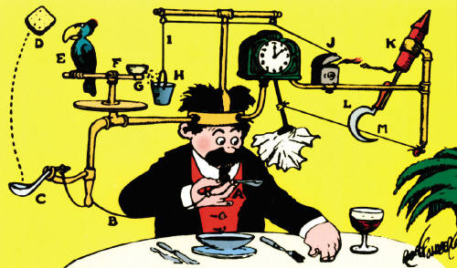
Rube Goldberg
(1883 – 1970)
Engineer, Inventor, Cartoonist

Slide 3
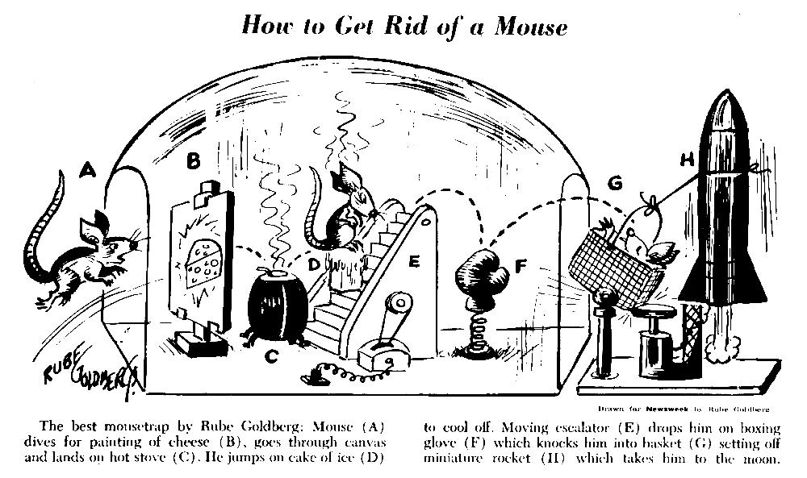
Rube Goldberg designs are meant to show the unnecessary complexities in machines

Slide 4
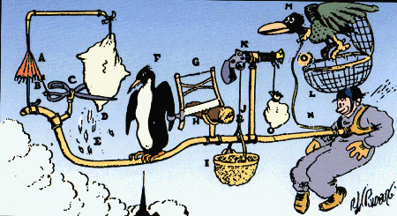
Webster’s definition of ‘Rube Goldberg’
A comically involved, complicated invention, laboriously contrived to perform a simple operation

Slide 5
How does your class turn off a light?
Insanity Kontraption

Slide 6
How to get started
Select --
an end goal
size
theme
materials
Gather ideas (Check out this and this)
Make a rough plan!
major components
connectors
Notes:
Major components are the big showy parts of the machine.
Connectors are things such as domino runs, cars or balls rolling from one section to another, or items dropping onto other parts of the machine. These are used to transfer the energy between the larger, more technical parts of the machine.

Slide 7
Building and Testing
Test each major and secondary component separately
Modify until they work at least 90% of the time
Link them together with connectors
Test and modify (use safety gaps!)
Don’t get discouraged!
Good advice from other builders – here
Fasten parts (domino run ‘hinges’)
Clean up your design
Add thematic and artistic elements
Add humor!
Notes:
Safety gaps – pieces added (or removed) to stop the flow of energy at that point. These are used to keep the machine from ‘tripping’ accidentally during the building and testing phases. Just be sure to remove them all before starting the filmed ‘run’.
Domino hinges are pieces of tape that affix the domino on the side it will fall on, so that they can be set back up quickly.
The use of a theme, the addition of artistic elements and humor all add points in the judging of the machine.

Slide 8
Energy Types and Forms
Kinetic
Mechanical
Thermal
Sound
Electrical
Radiant
Potential
Nuclear
Chemical
Gravitational
Elastic

Slide 9
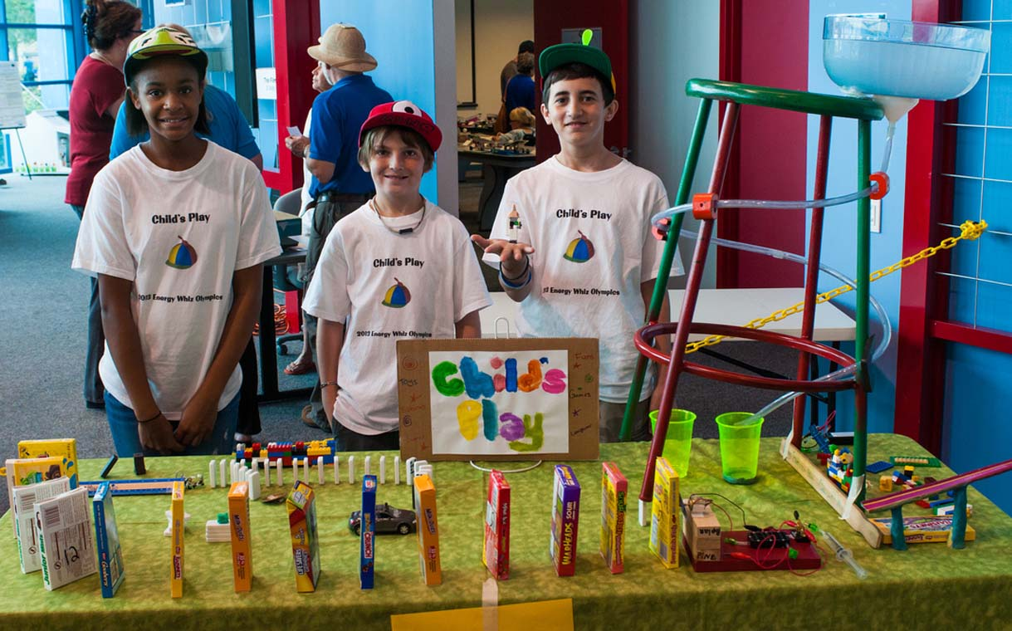
Energy Transfer Machine Competition
At EnergyWhiz

Slide 10
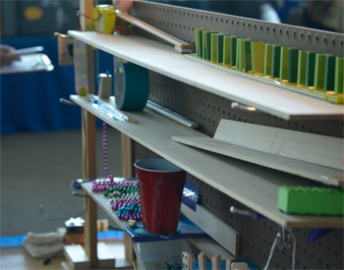
ETM Rules
The teams:
consist of 2 – 6 students in grades 4 – 12
submit a video of their machine in action
are judged on complexity, creativity, number of energy transfers and the team’s ability to explain their machine
Rules for the ETM competition: http://www.fsec.ucf.edu/go/energywhiz
Notes:
Repetitions of the same thing (i.e. a string of dominoes falling) is considered one ‘step’
The electricity from the battery should be used in a meaningful way—for example, using the battery as a pendulum or as a counter-weight, is not considered a good way to use the battery!
Teams choose their own end goal—ringing a bell, flipping over a playing card, watering a plant, etc., and then design their machine to complete this end goal as close (+ or -) to 1 minute as possible. Points are awarded for the accuracy of their timing.

Slide 11
Here’s one from last year!
2018 SECME Entry Carillon Elementary

Slide 12
Now that you know what to do-- let’s BUILD SOMETHING!

Slide 13
Challenge
Each team will--
Build an Energy Transfer Machine
that captures a rubber duck
uses at least five energy transfers
Share their machine with the group including
team introduction
machine description including energy transfers performed
Evaluate the machines built by other groups

