Slide 1
EnergyWhiz Engineering
OCPS STEM Day
August 7, 2019

Slide 2
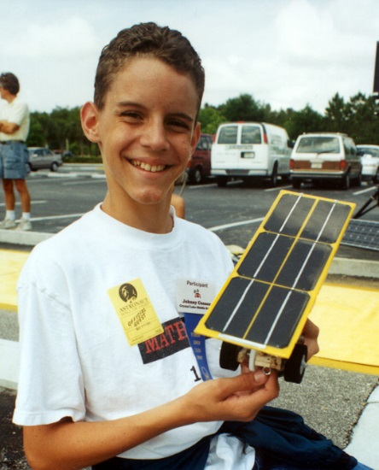
Why EnergyWhiz competitions?
Exciting engineering challenges
Requires problem-solving and creative thinking
Encourages teamwork
Applies STEAM skills
Focuses on learning by doing
Notes:
EnergyWhiz is the umbrella term for various hands-on engineering competitions conducted and/or created by the Florida Solar Energy Center, a research institute of the University of Central Florida.

Slide 3
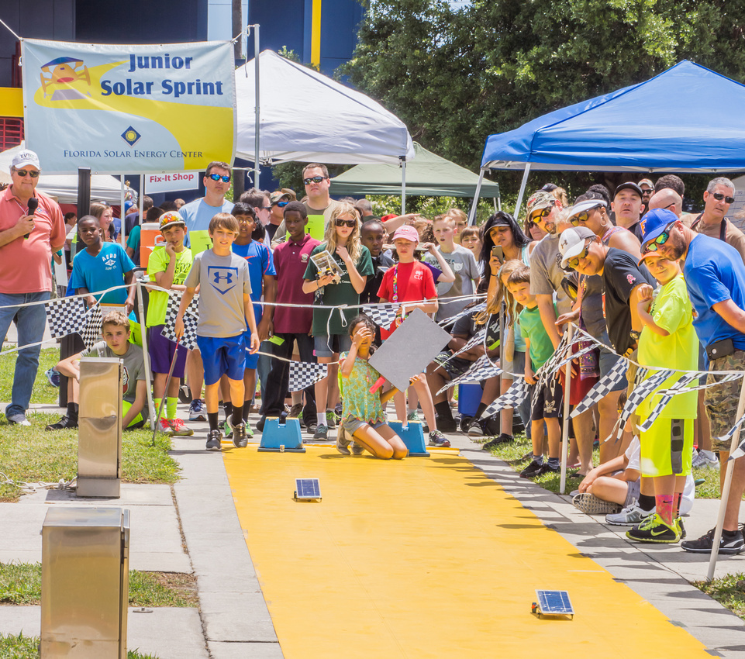
Junior Solar Sprint (JSS)
Design and build a model-size solar electric car to showcase in a head-to-head race
Notes:
JSS is a national competition created by Argonne National labs back in the early 1990’s and or

Slide 4
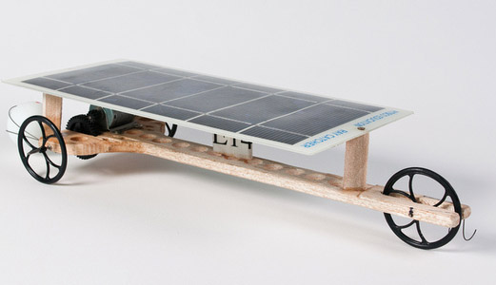
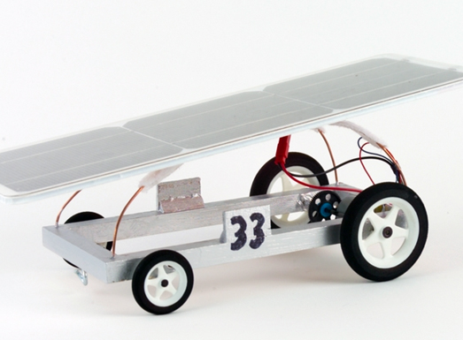
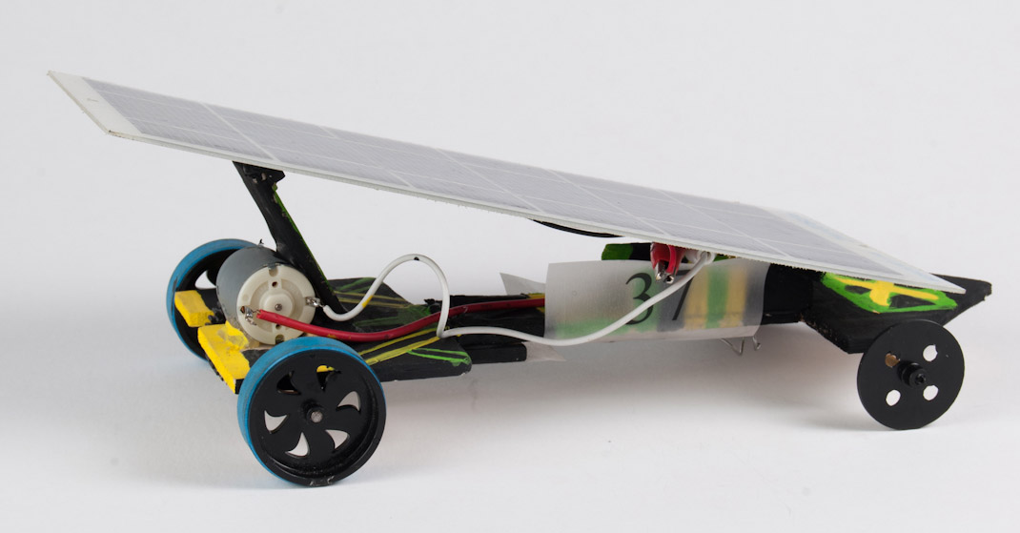
JSS cars
Notes:
Vehicles from JSS competitions held over the past 20 years or so.

Slide 5
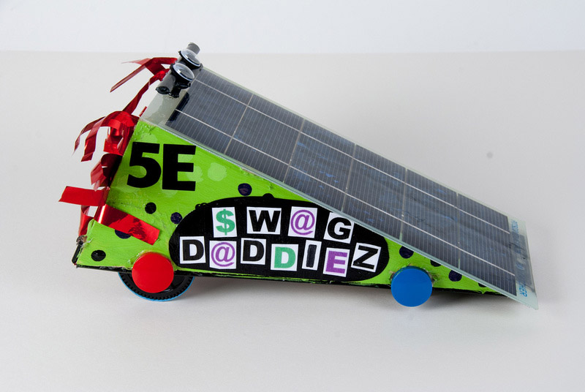
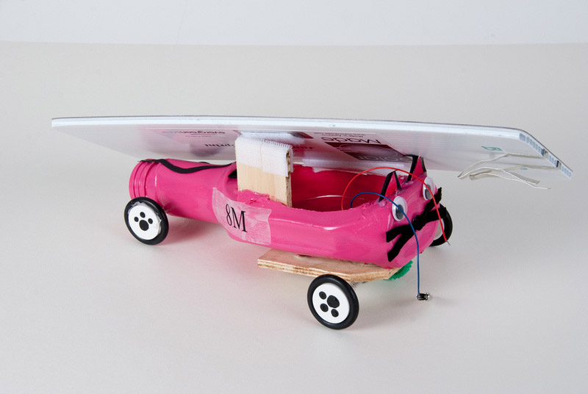
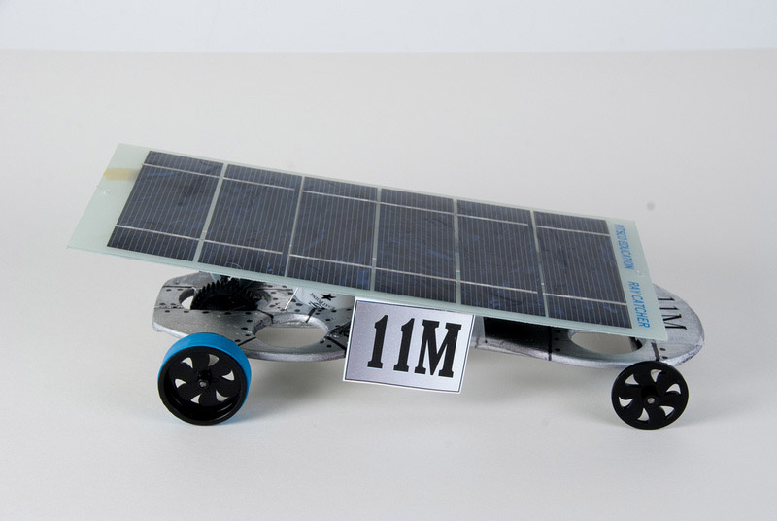
JSS cars
Notes:
More vehicles!

Slide 6
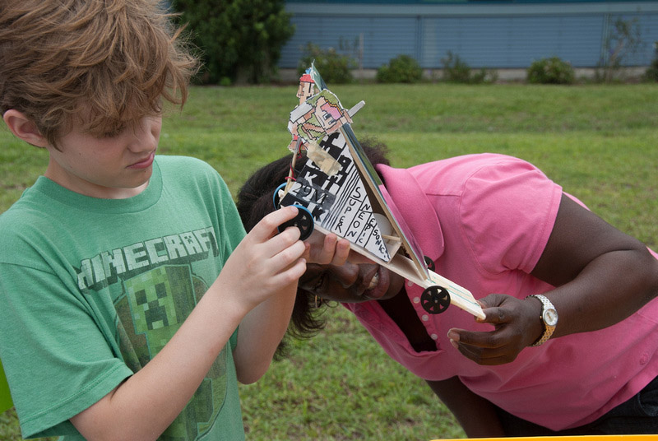
JSS Rules
2 – 4 students per team
Must use ‘sanctioned’ photovoltaic panel & motor
Include an easy to attach eyelet
Racetrack is 20m long. The cars run on a monofilament line
Notes:
Rules are refined on a yearly basis but some basic rules are recognized nationally and adhered to by TSA, AEOP, NREL and other organizers.

Slide 7
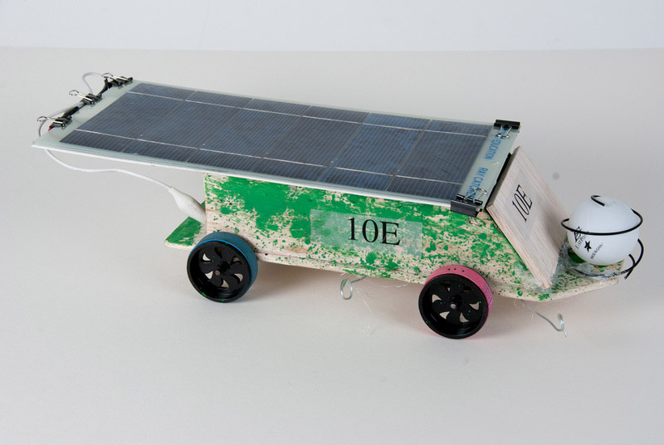
JSS Rules
The car must:
be able to carry a ping pong ball ‘passenger’
include a AA battery holder
be designed, fabricated, and raced by students only
Teams must document their engineering process!
Notes:
FSEC has added some additional rules. These requirements elevate the Florida competition and also take into account unpredictable changing weather conditions. These include adding batteries for cloudy/rainy conditions, engineering the design to also carry a removable ping-pong ball and interviewing teams to verify student team participation in the design and building of the vehicle.

Slide 8
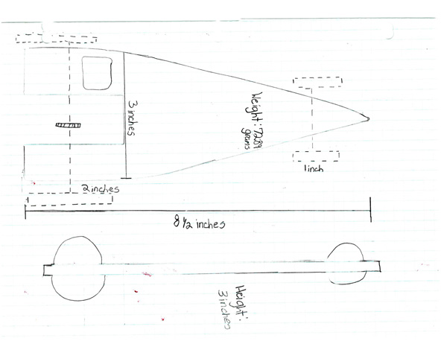
JSS Rules – Design Notebook
Title page
Project log
Design drawings (min. 2)
Finished car specifications
Test results (min. 3)
Photos
Notes:
Title page – school, team member names Project Log – daily entries, obstacles encountered & modification made Design drawings (minimum of 2) Finished car specifications – measurements, parts used & cost
Test results – how many trials? Was the car tested attached to a monofilament line in sunlight or with batteries or both? Did they time the trials or race against another vehicle? timed? If so include that information. Photos of the process and results.

Slide 9
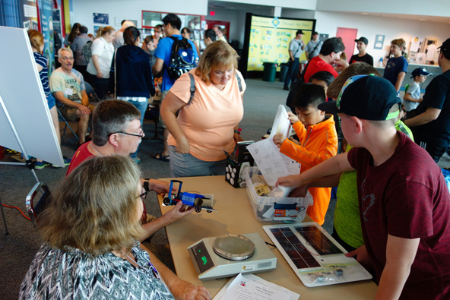
JSS Competition Day
Check in
Cars inspected for rule compliance
Team receives a ping pong ball, number decal and interview time
Design notebook is kept for judging

Slide 10
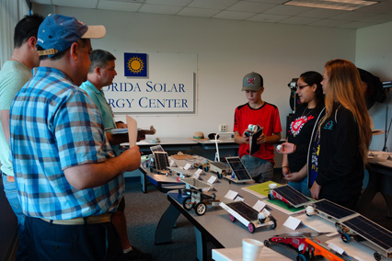
JSS Design Judging
Cars are judged on design, construction, materials used and creativity
During the interview, teams are judged on their knowledge of their car build and performance, and team dynamics

Slide 11
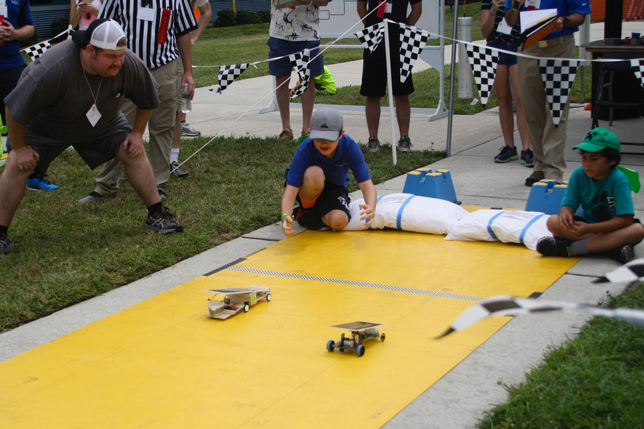
Junior Solar Sprint Race
Time Trials
Up to 3 trials
Ten fastest cars advance to Double Elimination
Double Elimination
Teams race two at a time
Teams eliminated with second loss

Slide 12
Just For You – JSS Hints & Tips
Build as lightweight as possible
Chassis should be rigid enough to hold motor securely
Axles need to be parallel for car to run straight
Gears must mesh securely
Approximate gear ratio between motor and axle is 1:4
+ Speed = - Torque and + Torque = - Speed
Use pieces of drinking straws to hold the axles, and as bushings to keep wheels from rubbing the car sides
Binder combs work great for an eyelet
The bottom of the eyelet should be very close to the track

Slide 13
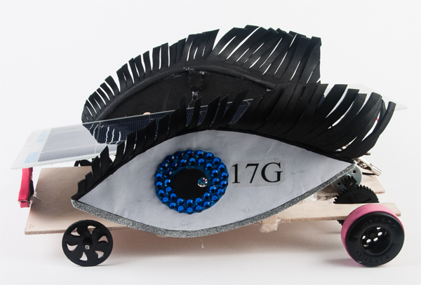
Junior Solar Sprint - Questions?

Slide 14
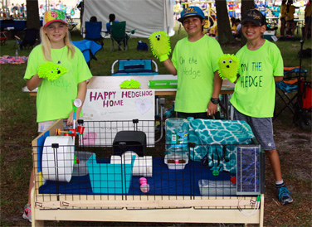
Critter Comfort Cottage (C3)
Design, build, and market
an energy-efficient, cost-effective, ‘green’ animal habitat

Slide 15
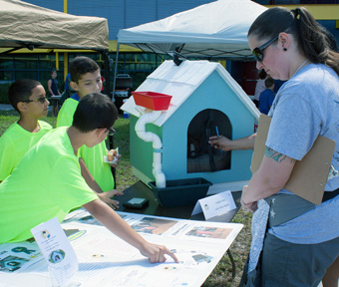
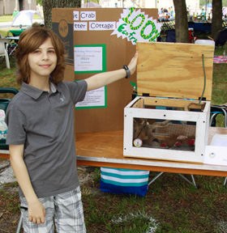
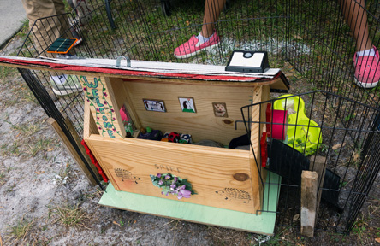
Critter Comfort Cottages
Notes:
Examples of engineered “green habitats”.

Slide 16
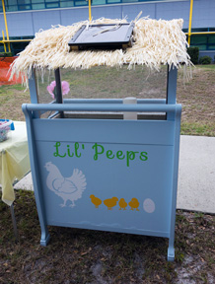
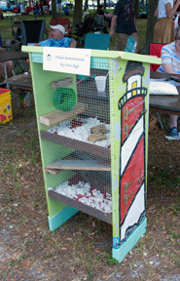
Critter Comfort Cottages
Notes:
More examples.

Slide 17
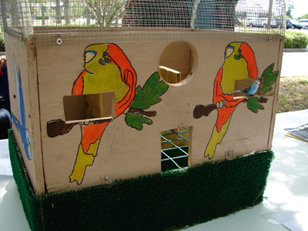
C3 Rules
Teams consist of 2 – 6 students
The cottage must:
  be animal-centric
  be safe and appropriate for the selected animal
The cottage must not:
  include a live animal at the competition
  have any sharp edges

Slide 18
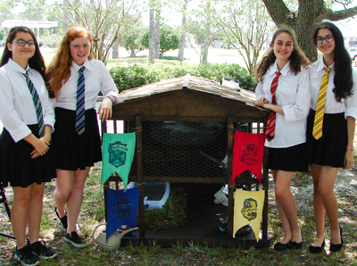
C3 Rules
The team
Researches the habits and needs of their selected animal and uses this in their design
Creates a marketing plan for their habitat. This could include:
  brochure, handouts
  poster, signage
  web page, video clip
  a theme

Slide 19
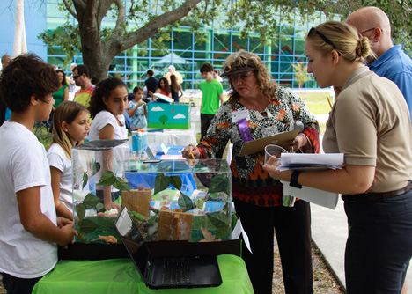
C3 Competition Day
Habitats are judged on:
green building materials, energy efficiency
quality of construction, durability
suitability for selected critter
creativity
Teams are judged on:
animal knowledge
marketing materials
team dynamics

Slide 20
Just For You - C3 Hints & Tips
Teams should
Research the animal’s needs and talk with an expert
  consider size of the habitat, temperature, and air flow
  allow for access to the animal and habitat hygiene
  consider the comfort of the critter—food, water, exercise, sleep, enrichment
Research green building techniques and materials, and renewable energy (if using)
Avoid toxic materials (such as paint)
Build their design for the intended conditions and the chewing habits of their animal

Slide 21
Just For You - C3 Hints & Tips
For successful marketing, teams should
Create marketing materials as if they are actually selling their product.
  create interest in their product
  explain how their design is good for the animal
Team members should be able to explain their design decisions to the judges
This is a good time to show school or team spirit
Make it interesting!

Slide 22
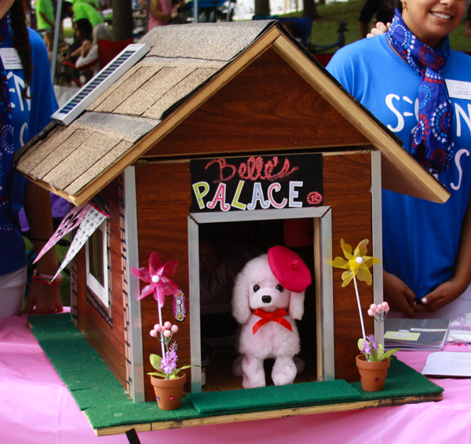
Critter Comfort Cottage - Questions?
Notes:
Rube Goldberg was an engineer, inventor and cartoonist….however he is most well-known now for the comical ‘machines’ that are named after him.
As a child, Rube loved to draw. But his father wanted him to get a good job, so he urged him to get a degree in engineering. Rube did, and graduated from the Univ of California (Berkeley), and went to work with the city of San Francisco in their water department. However, engineering as a career didn’t suit him, and he quit after six months to take a job as a cartoonist, landing within a year in NYC at the New York Evening Mail where he ended up making $50,000 a year by 1915!

Slide 23
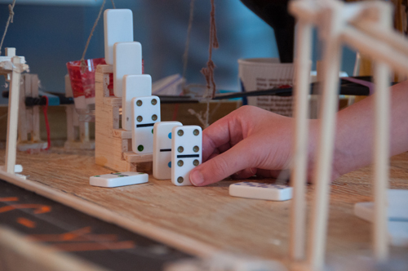
Energy Transfer Machine (ETM)
Video
Teams transform materials into Rube Goldberg-type machines that perform a specified task and submit a video of their success
Notes:
Rube Goldberg was an engineer, inventor and cartoonist….however he is most well-known now for the comical ‘machines’ that are named after him.
As a child, Rube loved to draw. But his father wanted him to get a good job, so he urged him to get a degree in engineering. Rube did, and graduated from the Univ of California (Berkeley), and went to work with the city of San Francisco in their water department. However, engineering as a career didn’t suit him, and he quit after six months to take a job as a cartoonist, landing within a year in NYC at the New York Evening Mail where he ended up making $50,000 a year by 1915!

Slide 24
ET Machines
2018 SECME Entry
Carillon Elementary
Notes:
Rube Goldberg was an engineer, inventor and cartoonist….however he is most well-known now for the comical ‘machines’ that are named after him.
As a child, Rube loved to draw. But his father wanted him to get a good job, so he urged him to get a degree in engineering. Rube did, and graduated from the Univ of California (Berkeley), and went to work with the city of San Francisco in their water department. However, engineering as a career didn’t suit him, and he quit after six months to take a job as a cartoonist, landing within a year in NYC at the New York Evening Mail where he ended up making $50,000 a year by 1915!

Slide 25
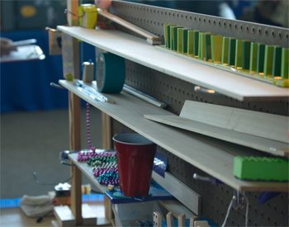
ETM Rules
Teams consist of 2 – 6 students
The machine shall:
  have a minimum of 5 steps
  use a battery in one step
  perform an end goal as close to the 1 minute mark as possible
  be videotaped for submission

Slide 26
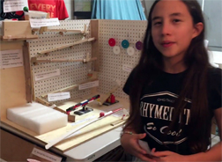
ETM Video Rules
The team must:
  explain the steps in the machine
  explain how the electricity is used
  state their end goal
The machine run portion of the video must be shot in one take without edits
Videos are submitted by email

Slide 27
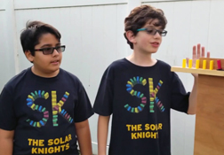
ETM Competition Day
Machine/videos are judged on:
number of energy transfers
complexity
creativity
effective use of the battery power
machine explanation
Team Interviews are judged on:
knowledge of energy transfers and concepts
team dynamics

Slide 28
Just For You - ETM Hints & Tips
Use a theme or humor—Rube Goldberg machines are supposed to be humorous!
Use unusual objects
Don’t use too many domino runs or pre-made marble run parts
YouTube videos are full of creative ideas
For a good video
  turn on all the available lights, and turn your phone on its side
  tell your students to speak loudly and clearly
  record the video at the highest quality settings available

Slide 29
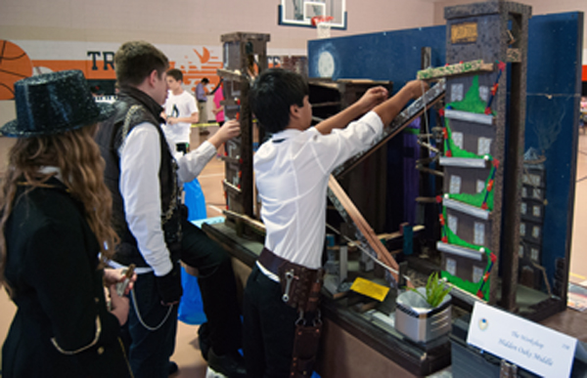
ETM - Questions?

Slide 30
How did we do?

